Slide 1
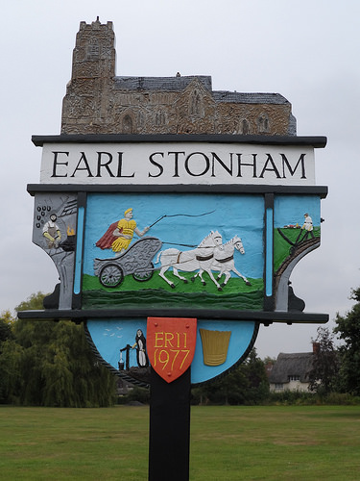
Norwich 2 Tilbury Project
Earl Stonham Parish Council
Consultation Event 1
Tuesday 4 June 2024

Slide 2
Agenda
Opening and Presentation (10 mins)
Table Discussions – focusing on harms and mitigations (45 mins)
Feedback to plenary session (30 mins)
Question Time (15 mins)
Next steps and close

Slide 3
Purpose & Format of tonight’s meeting
Organised by Earl Stonham Parish Council, supported by a small working group.
To inform ESPC’s formal response to the National Grid (NG) Consultation which now closes at 23.59 on Friday 26 July 2024.
Essex, Suffolk, Norfolk Pylon Group have produced a template to aid Parish Councils in writing their response.
Seek residents’ views on NG Proposals for our Parish to include within our submission.

Slide 4
This evening, we will be focusing on 2 areas within the template
Local harm to heritage, archaeology, environment, habitat & species, landscape, impact on farming, proximity to houses or businesses, public rights of way, breaches of Holford Rules governing routing of Pylons, and anything else that is specific to us
Mitigation - In the event that the NG Proposal gains approval what adjustments do we want to be made e.g. movements of certain pylons or and access roads.
We will not be looking at flaws in the consultation process or the technical aspects of alternatives e.g. undergrounding, sub-sea route. We do not have the technical expertise, but we will be drawing on the Pylon group and others to include this within our response.

Slide 5
NG Proposals
New 400Kv electricity transmission connection of around 184Km running from Norwich Main Substation to Tilbury Substation
159km of new overhead line and 25Km of underground cabling
50m high pylons (height of 10 double decker buses)
Temporary construction – haul roads to access work areas as well as providing temporary areas to store materials, vehicles and staff welfare facilities.
Following Consultation, submission of Development Consent Order to Planning Inspectorate in 2025.

Slide 7
Next Steps
Develop Draft PC Objection Letter using template
This will be available for download from the Village website for you to read prior to a further public meeting to be held at the Village Hall on
Wednesday 10 July 7pm to 9pm
Incorporate ESN Pylon Group information, including legal opinions as they become available

Slide 8
What you can do now
Say that you OBJECT and that you endorse the submission of the Essex Suffolk Norfolk Pylons action group. Say that you have never been presented with alternatives and that the one proposed creates unacceptable harm.
Set out all the HARMS caused by the project in this village. Harms to habitat, heritage, rights of way, businesses. Any harms you can think of!
Finally, think about specific ‘mitigations’, should the project go ahead. That might mean that an ancient oak tree should be avoided, or an access road changed, or an archaeological site bypassed.
www.pylonseastanglia.co.uk/actions/
contact@n-t.nationalgrid.com

